Slide 1
http://www.vidyanidhi.com/
ketkiacharya.net@gmail.com
Ketki Acharya
From: SM VITA ATC of CDAC
ketkiacharya.net@gmail.com

Slide 2
Entity -ORM
Entity Framework is an open-source ORM framework for .NET applications supported by Microsoft.
It enables developers to work with data using objects of domain specific classes without focusing on the underlying database tables and columns where this data is stored.
With the Entity Framework, developers can work at a higher level of abstraction when they deal with data, and can create and maintain data-oriented applications with less code compared with traditional applications.
O/RM includes three main parts:
Domain class objects,
Relational database objects and
Mapping information on how domain objects map to relational database objects (tables, views & storedprocedures).

Slide 3
Entity framework is useful in three scenarios.
First, if you already have existing database or you want to design your database first than other parts of the application.[Schema first]
Second, you want to focus on your domain classes and then create the database from your domain classes. [Code First]
Third, you want to design your database schema on the visual designer and then create the database and classes.[Design first]

Slide 4
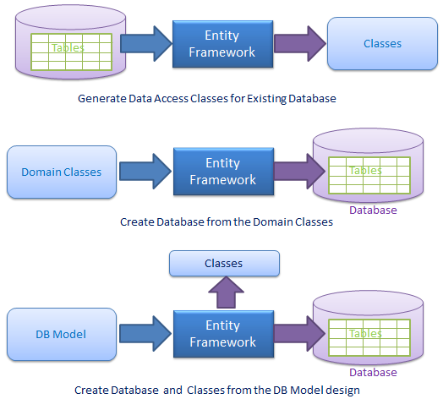

Slide 5
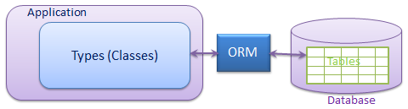
ORM allows us to keep our database design separate from our domain class design.
This makes the application maintainable and extendable.
It also automates standard CRUD operation (Create, Read, Update & Delete)
so that the developer doesn't need to write it manually.
Typical ORM tool generates classes for the database interaction for your application as shown below.
There are many ORM frameworks for .net in the market like
DataObjects.Net, NHibernate, OpenAccess, SubSonic etc.
Entity Framework is an open source ORM framework from Microsoft.
Please note that Entity Framework is an open source framework by Microsoft.

Slide 6
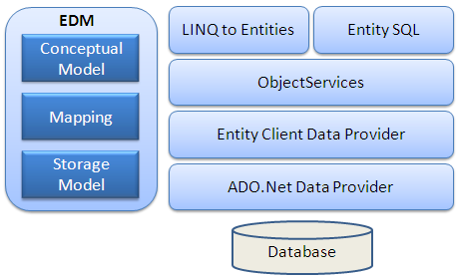
EDM (Entity Data Model): EDM consist three main parts- Conceptual model, Mapping and Storage model.
Conceptual Model: The conceptual model contains the model classes and their relationships. This will be independent from your database table design.(CSDL)
Conceptual schema definition language (CSDL)
Storage Model: Storage model is the database design model which includes tables, views, stored procedures and their relationships and keys.( SSDL)
Store schema definition language (SSDL)
Mapping: Mapping consist information about how the conceptual model is mapped to storage model.(MSL)
Mapping specification language (MSL)

Slide 7
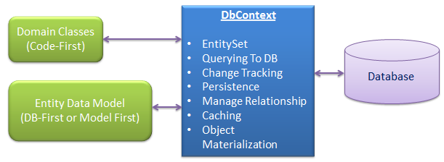
DbContext
DbContext is responsible for the following activities:
EntitySet: DbContext contains entity set (DbSet<TEntity>) for all the entities which is mapped to DB tables.
Querying: DbContext converts LINQ-to-Entities queries to SQL query and send it to the database.
Change Tracking: It keeps track of changes occurred in the entities after it has been querying from the database.
Persisting Data: It also performs the Insert, update and delete operations to the database, based on the entity states.
Caching: DbContext does first level caching by default. It stores the entities which has been retrieved during the life time of a context class.
Manage Relationship: DbContext also manage relationship using CSDL, MSL and SSDL in DB-First or Model-First approach or using fluent API in Code-First approach.
Object Materialization: DbContext converts raw table data into entity objects.

Slide 8
What is an Entity in Entity Framework?
An entity in Entity Framework is a class that maps to a database table.
This class must be included as a DbSet<TEntity> type property in the DbContext class.
EF API maps each entity to a table and each property of an entity to a column in the database.
public class Student
{
public int StudentID { get; set; }
public string StudentName { get; set; }
public DateTime? DateOfBirth { get; set; }
public byte[] Photo { get; set; }
public decimal Height { get; set; }
public float Weight { get; set; }
public Grade Grade { get; set; }
}
public class Grade
{
public int GradeId { get; set; }
public string GradeName { get; set; }
public string Section { get; set; }
public ICollection<Student> Students
{ get;set; }
}
Scalar Property
The primitive type properties are called scalar properties.
Each scalar property maps to a column in the database table
which stores an actual data.
For example,
StudentID,
StudentName,
DateOfBirth,
Photo,
Height, Weight
are the scalar properties in the Student entity class.
Navigation Property
The navigation property represents a relationship to another entity.
If an entity includes a property of another entity type, it is called a Reference Navigation Property.
It points to a single entity and represents multiplicity of one (1) in the entity relationships.
EF API will create a ForeignKey column in the table for the navigation properties that points
to a PrimaryKey of another table in the database.
For example, Grade are reference navigation properties in the following Student entity class.

Slide 9
What is an Entity in Entity Framework?
The above classes become entities when they are included as
DbSet<TEntity> properties in a context class (
the class which derives from DbContext), as shown below.
public class SchoolContext : DbContext
{
public SchoolContext()
{
}
public DbSet<Student> Students { get; set; }
public DbSet<Grade> Grades { get; set; }
}
In the above context class, Students, and Grades properties of type
DbSet<TEntity> are called entity sets.
The Student, and Grade are entities.
EF API will create the Students and Grades tables in the database,

Slide 10
POCO Entities (Plain Old CLR Object)
A POCO entity is a class that doesn't depend on any framework-specific base class. It is like any other normal .NET CLR class, which is why it is called "Plain Old CLR Objects".
public class Student
{
public int StudentID { get; set; }
public string StudentName { get; set; }
public DateTime? DateOfBirth { get; set; }
public byte[] Photo { get; set; }
public decimal Height { get; set; }
public float Weight { get; set; }
public StudentAddress StudentAddress { get; set; }
public Grade Grade { get; set; }
}
These POCO entities (also known as persistence-ignorant objects) support most of the same query, insert, update, and delete behaviors as entity types that are generated by the Entity Data Model. The following is an example of Student POCO entity.

Slide 11
Dynamic Proxy Entities (POCO Proxy)
Dynamic Proxy is a runtime proxy class which wraps POCO entity. Dynamic proxy entities allow lazy loading.
Note: Dynamic proxy entities are only supported in EF 6. EF Core 2.0 does not support them yet.
A POCO entity should meet the following requirements to become a POCO proxy:
A POCO class must be declared with public access.
A POCO class must not be sealed (NotInheritable in Visual Basic).
A POCO class must not be abstract (MustInherit in Visual Basic).
Each navigation property must be declared as public, virtual.
Each collection property must be ICollection<T>.
The ProxyCreationEnabled option must NOT be false (default is true) in context class.
The following POCO entity meets all of the above requirements to become a dynamic proxy entity at runtime.
public class Student
{ public int StudentID { get; set; }
public string StudentName { get; set; }
public DateTime? DateOfBirth { get; set; }
public byte[] Photo { get; set; }
public decimal Height { get; set; }
public float Weight { get; set; }
public virtual StudentAddress StudentAddress { get; set; }
public virtual Grade Grade { get; set; }
}

Slide 12


Note: By default, dynamic proxy is enabled for every entity. However, you can disable dynamic proxy by setting
context.Configuration.ProxyCreationEnabled = false;
in the context class.
At runtime, EF API will create an instance of dynamic proxy for the above Student entity. The type of dynamic proxy for Student will be System.Data.Entity.DynamicProxies.Student, as shown below
Use ObjectContext.GetObjectType() to find the underlying wrapped type by the dynamic proxy as shown below:

Slide 13
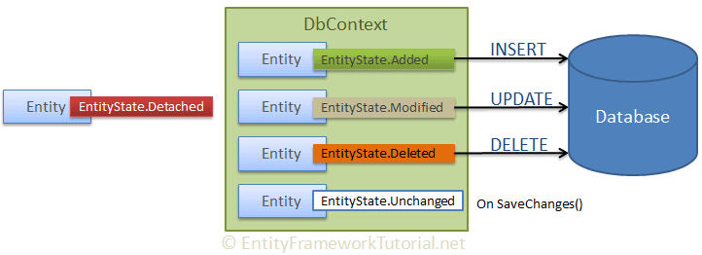
EntityState in Entity Framework
EF API maintain Each entity has a state based on the operation performed on it via the context class.
The entity state represented by an enum System.Data.Entity.
EntityState in EF 6 and Microsoft.EntityFrameworkCore.EntityState in EF Core with the following values:
Added Modified Deleted Unchanged Detached
The Context not only holds the reference to all the entity objects as soon as retrieved from the database,
but also keeps track of entity states and maintains modifications made to the properties of the entity.
This feature is known as Change Tracking.
The change in entity state from the Unchanged to the Modified state is the only state that's
automatically handled by the context. All other changes must be made explicitly using proper methods of DbContext or DbSet.
EF API builds and executes the INSERT, UPDATE, and DELETE commands based on the state of an entity when the context.SaveChanges() method is called.
It executes the INSERT command for the entities with Added state,
the UPDATE command for the entities with Modified state and
the DELETE command for the entities in Deleted state.
The context does not track entities in the Detached state.
The following figure illustrates the significance of entity states:ns the state of each entity during its lifetime.

Slide 14
Lazy Loading:
One of the important functions of Entity Framework is lazy loading. Lazy loading means delaying the loading of related data, until you specifically request for it. For example, Student class contains StudentAddress as a complex property. So, the context first loads all the students from the database, then it will load the address of a particular student when we access StudentAddress property as shown below.
using (var ctx = new SchoolDBEntities())
{
//Loading students only
IList<Student> studList = ctx.Students.ToList<Student>();
Student std = studList[0];
//Loads Student address for particular Student only (seperate SQL query)
StudentAddress add = std.StudentAddress;
}
public class Student
{ public int StudentID { get; set; }
public string StudentName { get; set; }
public DateTime? DateOfBirth { get; set; }
public byte[] Photo { get; set; }
public decimal Height { get; set; }
public float Weight { get; set; }
public virtual StudentAddress StudentAddress { get; set; }

Slide 15
However, you can also turn off lazy loading for a particular property or an entire context. To turn off lazy loading for a particular property, do not make it virtual.
To turn off lazy loading for all entities in the context, set its configuration property to false:
using System;
using System.Data.Entity;
using System.Data.Entity.Infrastructure;
using System.Data.Entity.Core.Objects;
using System.Linq;
public partial class SchoolDBEntities : DbContext
{
public SchoolDBEntities(): base("name=SchoolDBEntities")
{
this.Configuration.LazyLoadingEnabled = false;
}
protected override void OnModelCreating(DbModelBuilder modelBuilder)
{
throw new UnintentionalCodeFirstException();
}
}

Slide 16
Rules for lazy loading:
context.Configuration.ProxyCreationEnabled should be true.
context.Configuration.LazyLoadingEnabled should be true.
Navigation property should be defined as public, virtual.
Context will NOT do lazy loading if the property is not defined as virtual

Slide 17
Eager Loading:
using (var context = new SchoolDBEntities())
{
var res = (from s in context.Students.Include("Standard")
where s.StudentName == "Student1" select s). FirstOrDefault<Student>();
}
public class Standard
{
public Standard()
{
}
public int StandardId { get; set; }
public string StandardName { get; set; }
public ICollection<Student> Students { get; set; }
}
public class Student
{
public Student()
{
}
public int StudentID { get; set; }
public string StudentName { get; set; }
public DateTime? DateOfBirth { get; set; }
public byte[] Photo { get; set; }
public decimal Height { get; set; }
public float Weight { get; set; }
public Standard Standard { get; set; }
}
namespace EF_Code_First
{
public class SchoolContext : DbContext
{
public SchoolContext()
: base()
{
}
public DbSet<Student> Students { get; set; }
public DbSet<Standard> Standards { get; set; }
}
}

Slide 18
LINQ for querying against DbSet
The DbSet class is derived from IQuerayable. So, we can use LINQ for querying against DbSet, which will be converted to an SQL query. EF API executes this SQL query to the underlying database, gets the flat result set, converts it into appropriate entity objects and returns it as a query result.
The following are some of the standard query operators (or extension methods) that can be used with LINQ-to-Entities queries.
LINQ Extension Methods
First()
FirstOrDefault()
Single()
SingleOrDefault()
ToList()
Count()
Min()
Max()
Last()
LastOrDefault()
Average()
Find: this method of DbSet to search the entity based on the primary key value.

Slide 19
First/FirstOrDefault
If you want to get a single student object, when there are many students, whose name is "Bill" in the database, then use First or FirstOrDefault, as shown below:
using (var ctx = new SchoolDBEntities())
{
var student = (from s in ctx.Students
where s.StudentName == "Bill"
select s).FirstOrDefault<Student>();
}
using (var ctx = new SchoolDBEntities())
{
var student = ctx.Students
.Where(s => s.StudentName == "Bill")
.FirstOrDefault<Student>();
}

Slide 20
Parameterized Query
EF builds and executes a parameterized query in the database if the LINQ-to-Entities query uses parameters, such as below.
using (var ctx = new SchoolDBEntities())
{ string name = "Bill";
var student = ctx.Students
.Where(s => s.StudentName == name)
.FirstOrDefault<Student>();
}
The difference between First and FirstOrDefault is that First() will throw an exception if there is no result data for the supplied criteria, whereas FirstOrDefault() returns a default value (null) if there is no result data.

Slide 21
ToList
The ToList method returns the collection result. If you want to list all the students with the same name then use ToList():
using (var ctx = new SchoolDBEntities())
{
var studentList = ctx.Students.Where(s => s.StudentName == "Bill").ToList();
}
SELECT
[Extent1].[Id] AS [Id],
[Extent1].[Name] AS [Name],
[Extent1].[Qty] AS [Qty],
[Extent1].[Price] AS [Price]
FROM [dbo].[Product] AS [Extent1]
DemodataEntities db = new DemodataEntities();
var result = db.Products.ToList<Product>();
Console.WriteLine(db.Products);
//var lr = from rng in db.Products select rng;
foreach (var r in result)
Console.WriteLine("{0} {1} {2} {3}", r.Id, r.Name, r.Price, r.Qty);

Slide 22
GroupBy
Use the group by operator or GroupBy extension method to get the result based on the group by the particular property of an entity.
The following example gets the results grouped by each Standard. Use the foreach loop to iterate the group.
using (var ctx = new SchoolDBEntities())
{
var students = from s in ctx.Students
group s by s.StandardId into studentsByStandard
select studentsByStandard;
foreach (var groupItem in students)
{
Console.WriteLine(groupItem.Key);
foreach (var stud in groupItem)
{
Console.WriteLine(stud.StudentId);
}
}
using (var ctx = new SchoolDBEntities())
{
var students = ctx.Students.GroupBy(s => s.StandardId);
foreach (var groupItem in students)
{
Console.WriteLine(groupItem.Key);
foreach (var stud in groupItem)
{
Console.WriteLine(stud.StudentId);
}
}
}

Slide 23
OrderBy
Use the OrderBy operator with ascending/descending keywords in LINQ query syntax to get the sorted entity list.
using (var ctx = new SchoolDBEntities())
{ var students = from s in ctx.Students orderby s.StudentName ascending select s;
}
using (var ctx = new SchoolDBEntities())
{
var students = ctx.Students.OrderBy(s => s.StudentName).ToList();
// or descending order
var descStudents = ctx.Students.OrderByDescending(s => s.StudentName).ToList();
}

